Slide 1
MI Topic Proposal
Dear Advisors,
Here is our brief summary on our best 3 ideas!
By: Amanda & Forest

Slide 2
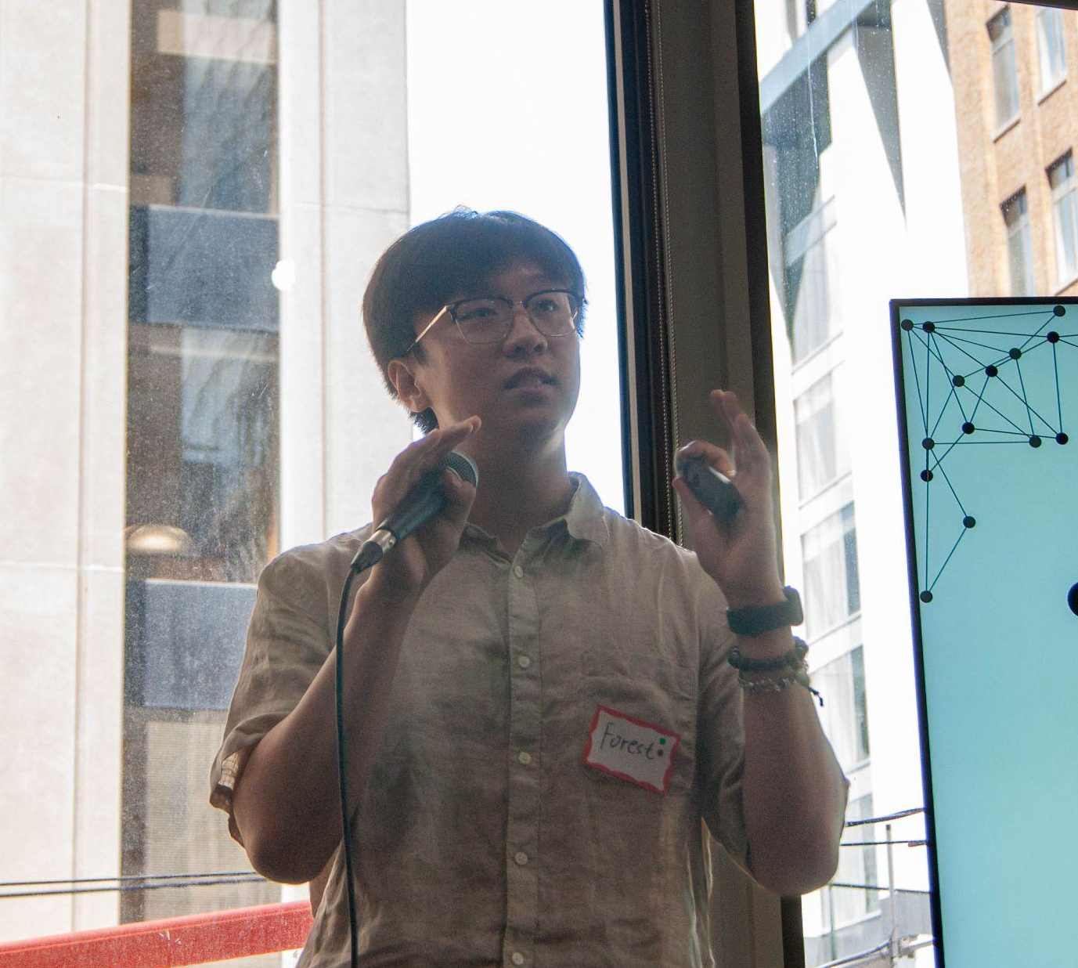
NOTE
This presentation is a simple brief of our proposal ideas with some market research to see if our stance is strong enough or not.
Goal:
We want to get your help on selecting the final idea
Any other ideas you may have
Any technological limitations / feasibility that you think apply
Couldn’t be with us here today, so here he is in spirit
Forest
2nd year - Rotman Commerce

Slide 3
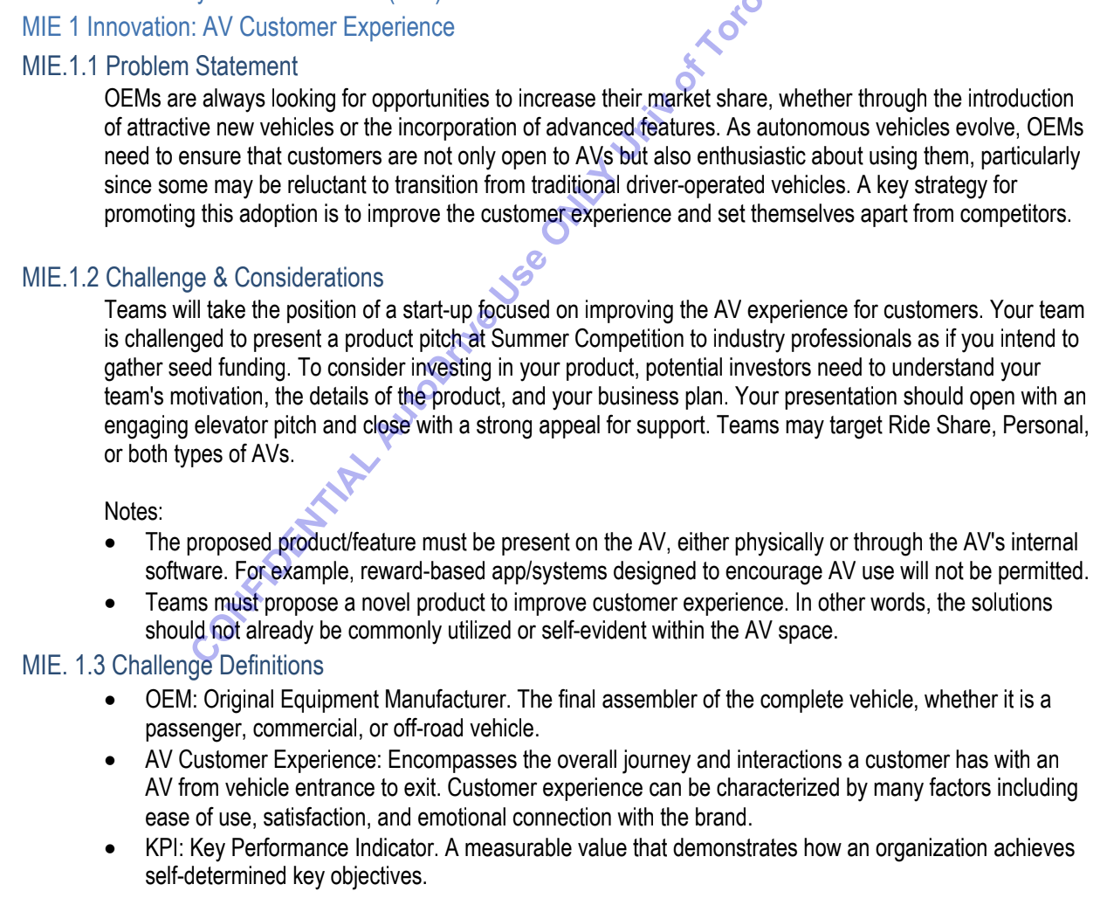
The Ruleset
Overview of what the prompt asks for
1) Promote transition from traditional vehicles to AV
2) Improve the AV experience for customers
3) Aim = startup business style

Slide 4
01
AutoPark
Smart Self-Parking Integration for Autonomous Vehicles
*Disclosure: None of the titles are confirmed/in their final form

Slide 5
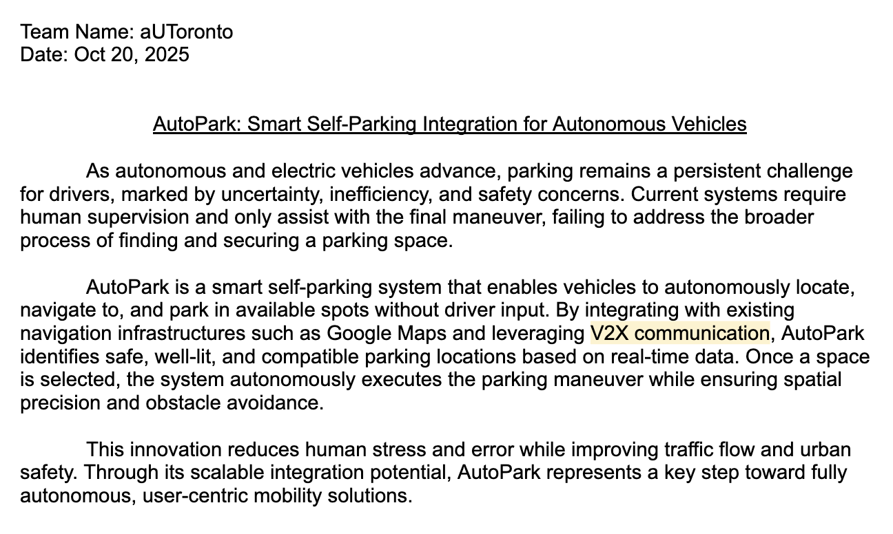
Topic Proposal Paragraph
*not sure if V2X is the most cost efficient/ within the possibility of a startup?

Slide 6
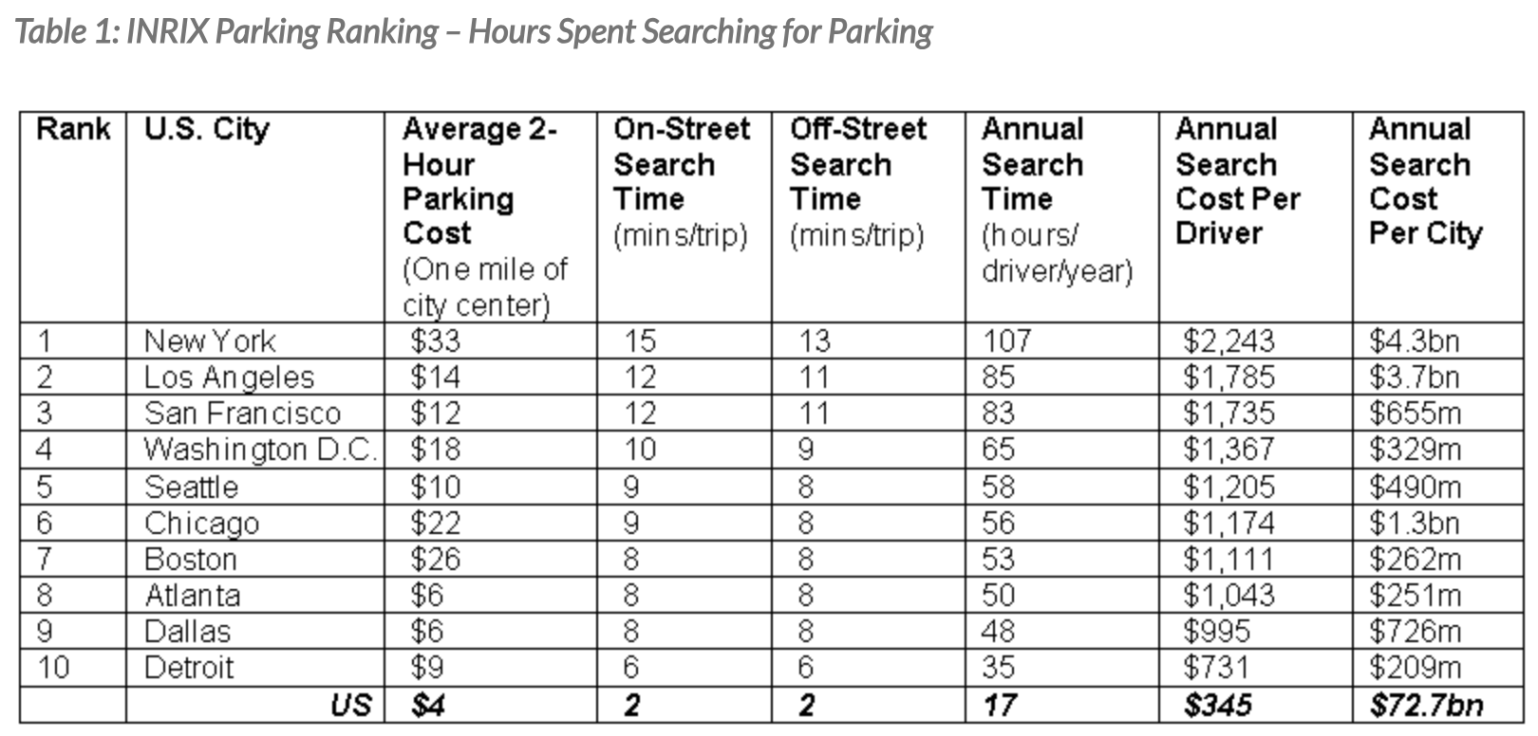
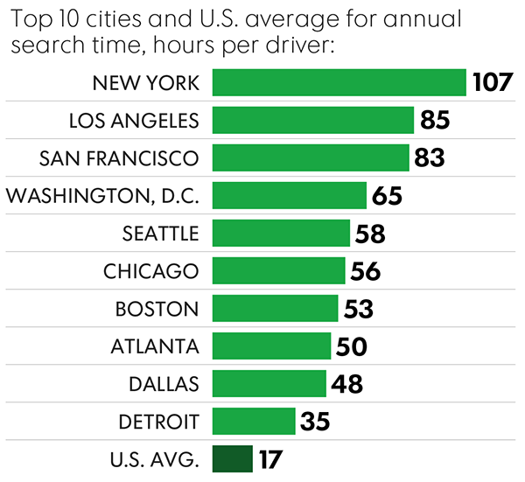
In a nutshell
01
The Problem:
Drivers spend an average of 107 hours/year (That's over 4.4 days) in New York City searching for parking.
This wastes time, fuel, and creates an estimated $72.7 billion in annual costs from wasted time and fuel in the US alone.
https://inrix.com/press-releases/parking-pain-us/ → The study done by INRIX Research

Slide 7
Market Size
02
Smart Parking Market:
In 2025, market research firms like Straits Research and Precedence Research place its value between $9.3 and $11.2 billion.
→ https://straitsresearch.com/report/smart-parking-market
! Projected to grow to over $33 billion by 2033
= 17.4% CAGR (compound annual growth rate) [17-20% range]
Research Firm | 2024 Estimate | 2025 Estimate
Straits Research | $7.98 Billion | $9.37 Billion
Precedence Research | $9.15 Billion | $11.18 Billion
The Business Research Co. | $8.5 Billion | $10.27 Billion
IMARC Group | $5.7 Billion | (No 2025, but a lower base)
It’s projected to increase due to the following factors
Urbanization and Congestion: More people are moving to cities, leading to a massive increase in vehicles, traffic congestion, and parking demand.
Environmental Concerns: Reducing the time spent "cruising" for parking directly reduces fuel consumption and carbon emissions, which is a major goal for cities and corporations.
Smart City Initiatives + IoT and Connectivity: Widespread adoption of IoT sensors, 5G, and cloud computing makes it cheaper and easier to get real-time data on which spots are open

Slide 8
Our Solution - Fits within the Prompt
1) Aides with the customer experience gap
Current systems (like basic Park Assist) only help with the final maneuver.
The most stressful part, finding the spot, is completely unsolved by current in-vehicle systems.
2) “Must be present on the AV”
Product: "AutoPark" is a licensable software module that runs on the vehicle's main ADAS/infotainment compute unit.
Not just a phone app
How it Works (V1)
Find: The driver selects “AutoPark.” The system uses navigation partners (Google Maps) and V2N (Vehicle-to-Network) services to find nearby garages with availability.
Reserve: It communicates via V2I (Vehicle-to-Infrastructure) or V2N to the parking provider's API to confirm a spot.
Navigate: After dropping off the passenger, the AV uses its onboard maps and sensor suite (Cameras, LiDAR, Radar) to navigate to the garage entrance.
Park: Using V2I data (e.g., “Proceed to Level 3, Spot B-12”), the AV navigates the garage and performs the final autonomous parking maneuver using its sensors and cameras, just like a high-end Park Assist system, but without a driver.
Pitch Angle:
We are all moving to autonomous vehicles to get our time back, yet the most stressful hours of our driving (looking for parking) is still a manual process.
→ “AutoPark solves the entire parking journey, not just the last 10 feet."
Notes:
Questions for @chad:
Is this technology feasible at our scope??

Slide 9
Stakeholders + Monetization
04
Stakeholder Analysis:
Primary Customer (B2B): Automotive OEMs (e.g., General Motors, Ford).
Why: In a feature war, where they need to differentiate their AVs.
Our “AutoPark” software module is a high-value, licensable feature they can build into their new vehicles.
End-User (B2C Experience): The AV Owner / Rider.
Why: Core “customer experience” value. They get a true “curbside-to-curbside” experience. They are dropped off at the door, and the car vanishes → handling the parking task entirely.
Key Partners (Data & Infrastructure):
Parking Infrastructure Owners: (e.g., municipalities, shopping malls, airports, commercial garages).
Provide the real-time data on which spots are open.
Data Aggregators: (e.g., Google Maps).
Need their APIs to find available lots, and they need your system to offer a premium "park-for-me" feature.
B2B Licensing Fee:
Charge OEMs a one-time “per-vehicle” license fee to install the AutoPark software.
OR
SaaS (Software as a Service): Charge OEMs a small annual subscription fee for V2N network access and map/partner updates, creating recurring revenue.

Slide 10
V2 → Beachhead Market
V1 Issues:
Reliant on citywide V2X and smart garage APIs
Low feasibility → Waits for the world to change
One-time fee
How It Works (V2):
EXAMPLE:
The AV drops the passenger at the airport terminal (“Drop-off Zone”).
The “AutoPark” software activates.
It asks the garage's "Lighthouse" (via a simple V2N/V2I data ping), “Where is the AutoPark-designated level?”
The Lighthouse pings back: "Proceed to Level 4."
The AV's own sensors (cameras/LiDAR) take over. It follows the existing painted arrows, reads existing signs ("Level 4," "Exit," "Stop"), and navigates the "semi-structured" garage environment.
Once on Level 4, it visually searches for any open spot (or one with a specific “AutoPark” logo) and parks itself.
! No longer relying on external corp’s sensors or real-time maps !
Our “Product” (V2)
The In-Vehicle Software (Core Product) = “AutoPark” module on the AV.
Pre-loaded with the “micro-maps” of partner locations.
The “Lighthouse” Beacon (= Enabler)
A single, low-cost piece of hardware (e.g., a Wi-Fi/5G broadcaster) that we install at the entrance of a partner garage.
-The Airport/Garage (gets their parking fee)
-Startup (gets a "platform fee" for the autonomous tech)
-The OEM (gets a "software fee" for having your module)
Revenue-Sharing:
Take a cut of every parking transaction
Business-to-Business-to-Consumer (B2B2C):
The driver pulls up to the terminal. The AV's infotainment screen asks:
“Welcome to Pearson Airport. Use AutoPark for a seamless drop-off? (Special rate: $15)”
Notes:
Creates a flywheel:
The more OEMs signed, the more valuable our service is to garages.
The more garages signed, the more valuable our software is to OEMs.

Slide 11
02
AutoLink
Modular Rear-End Attachment System for Connected Autonomous Vehicles
*Disclosure: None of the titles are confirmed/in their final form

Slide 12
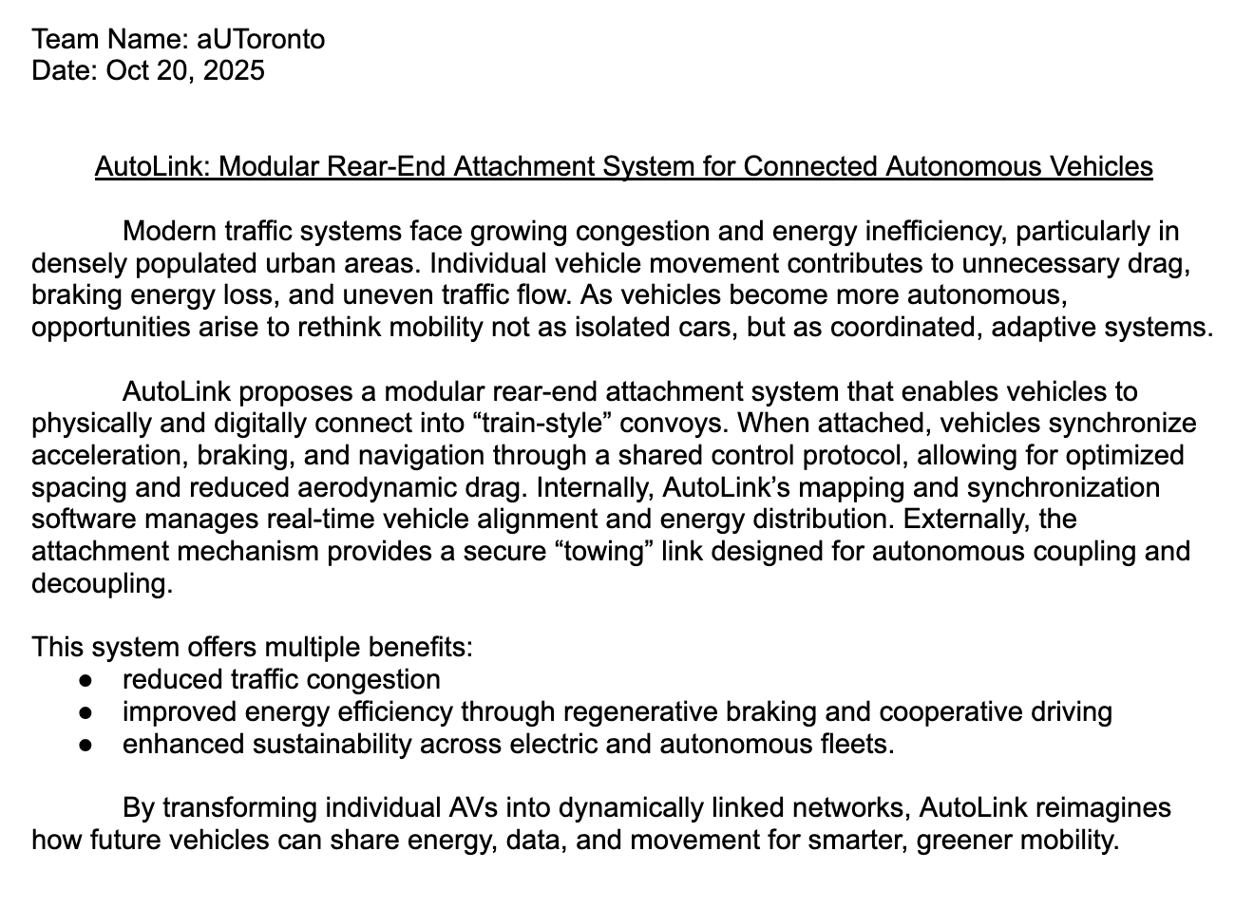
Topic Proposal Paragraph
1) Pain point-focus = congestion
2) How it works = synchronized acceleration, braking, navigation

Slide 13
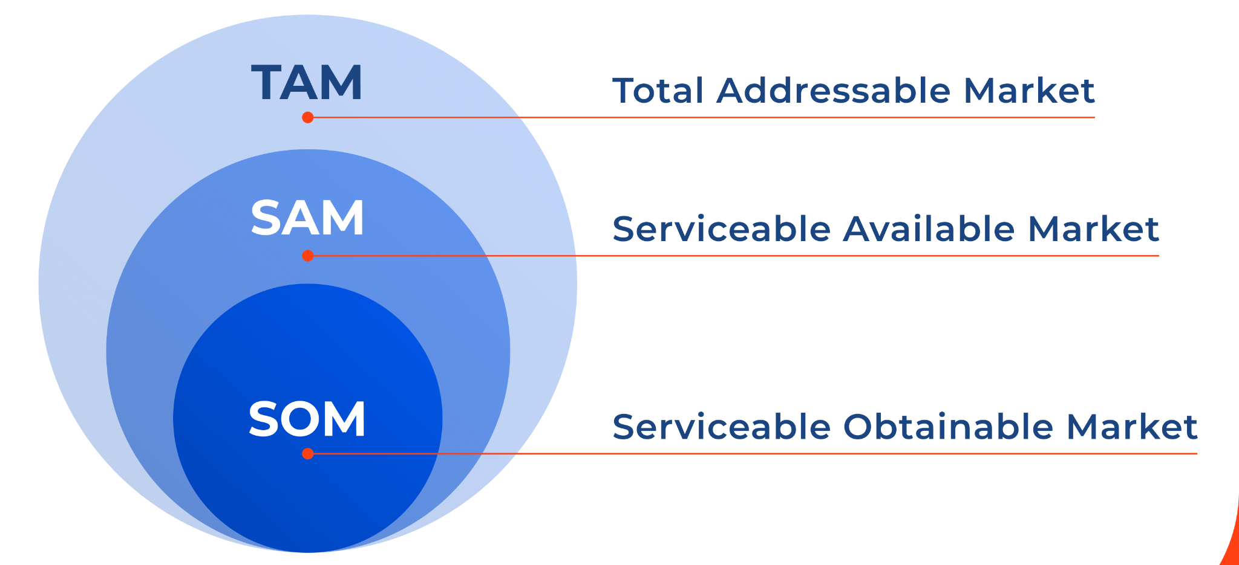
Overview
02
Product Scope:
What gets counted: any AutoLink-ready vehicle (ex: new AVs + retrofit-capable EVs/ADAS Level 3 - 4) that can participate in physical/digital platooning
Buyer: OEMs & fleets (license + optional hardware)
Growth driver: network effect, each added compatible vehicle increases utility
(convoy density → energy savings → more adoption).
Market Tier | Definition | Market Size (USD) | Vehicles (M units) | Notes / Sources
TAM | Global AV-capable vehicles that could support AutoLink (feature adoption across all connected and autonomous fleets by 2030) | ≈ $18.4 B / year | 12.0 M | Derived from global automotive platooning system market (USD 4.46 B → 18.38 B by 2029, CAGR 32.4%) and connected-car market (USD 12.4 B → 26.4 B by 2030) — The Business Research Company 2024 and Markets & Markets 2024. Represents total addressable AV ecosystem where AutoLink-like convoying could apply.
SAM | AV-capable vehicles in regions with legal / high-density platooning support (North America, EU, China ≈ 60% of global market) | ≈ $7.4 B / year | 4.8 M | 60 % regional availability × 70 % highway-fit filter ≈ 42 % of TAM. Reflects corridors actively piloting V2V and platooning standards.
SOM | 3–5 yr attainable penetration via early OEM & fleet partners (initial feature deployment) | ≈ $590 M / year | 0.42 M | ~8 % penetration of SAM by Year 5 — targets OEMs and autonomous fleets (Tesla, Volvo, Waymo, Cruise, BYD). Assumes ARPU ≈ $140 software license + $10 integration fee per vehicle.

Slide 14
Stakeholders + Monetization
04
Stakeholder Analysis:
Primary Customer (B2B): Automotive OEMs & Tier-1 Suppliers
Why: In a feature race, OEMs need differentiators that improve energy efficiency and range.
Our “AutoLink” module is a high-value, licensable hardware-software system that enables synchronized platooning and energy sharing.
OEMs can build it into their new AV and EV platforms as a premium connectivity feature
End-User (B2C / Fleet Experience): Fleet Operators & Autonomous Mobility Providers
Why: Fleet owners benefit from reduced energy consumption (~10–15% savings) and smoother traffic flow (solves traffic congestion)
Value: Provides a network-ready platform for connected fleets and ride-sharing operators.
Sell the physical “AutoLink Coupler” module to OEMs or Tier-1 suppliers for factory integration or aftermarket installation.
AND
Charge OEMs an annual subscription per connected vehicle to maintain access to the AutoLink network.
Notes:
Prithvi takeover pres from here

Slide 15
03
VISTA
Visual Intelligent System for Transparent Awareness
*Disclosure: None of the titles are confirmed/in their final form

Slide 16
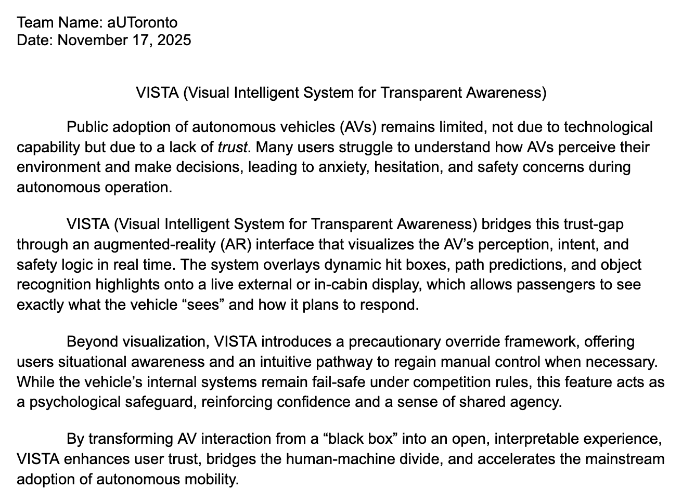
Topic Proposal Paragraph

Slide 17
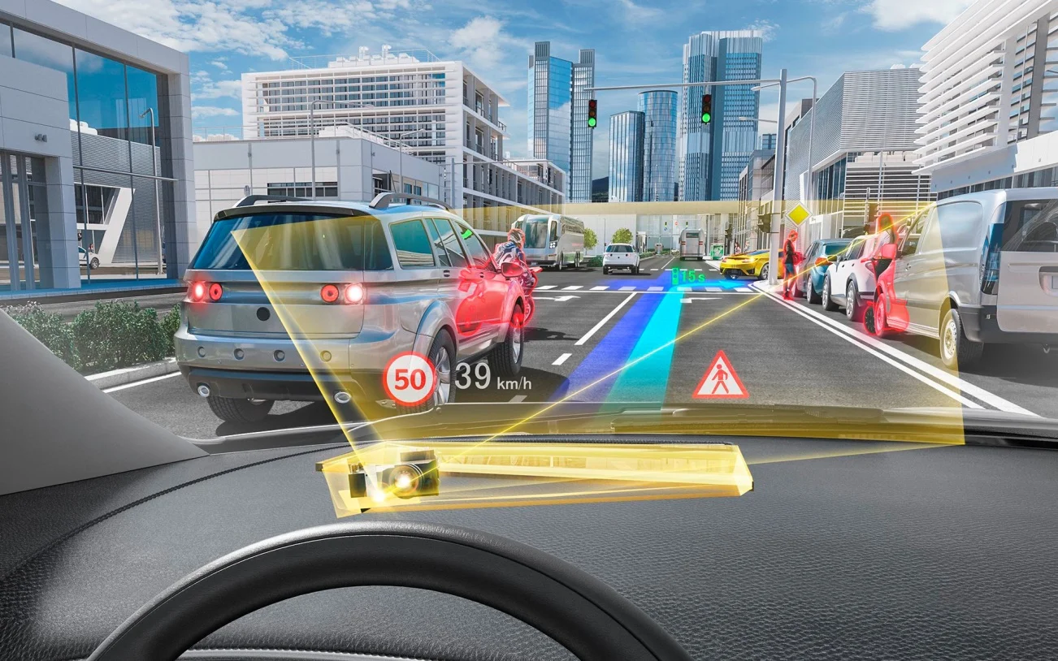
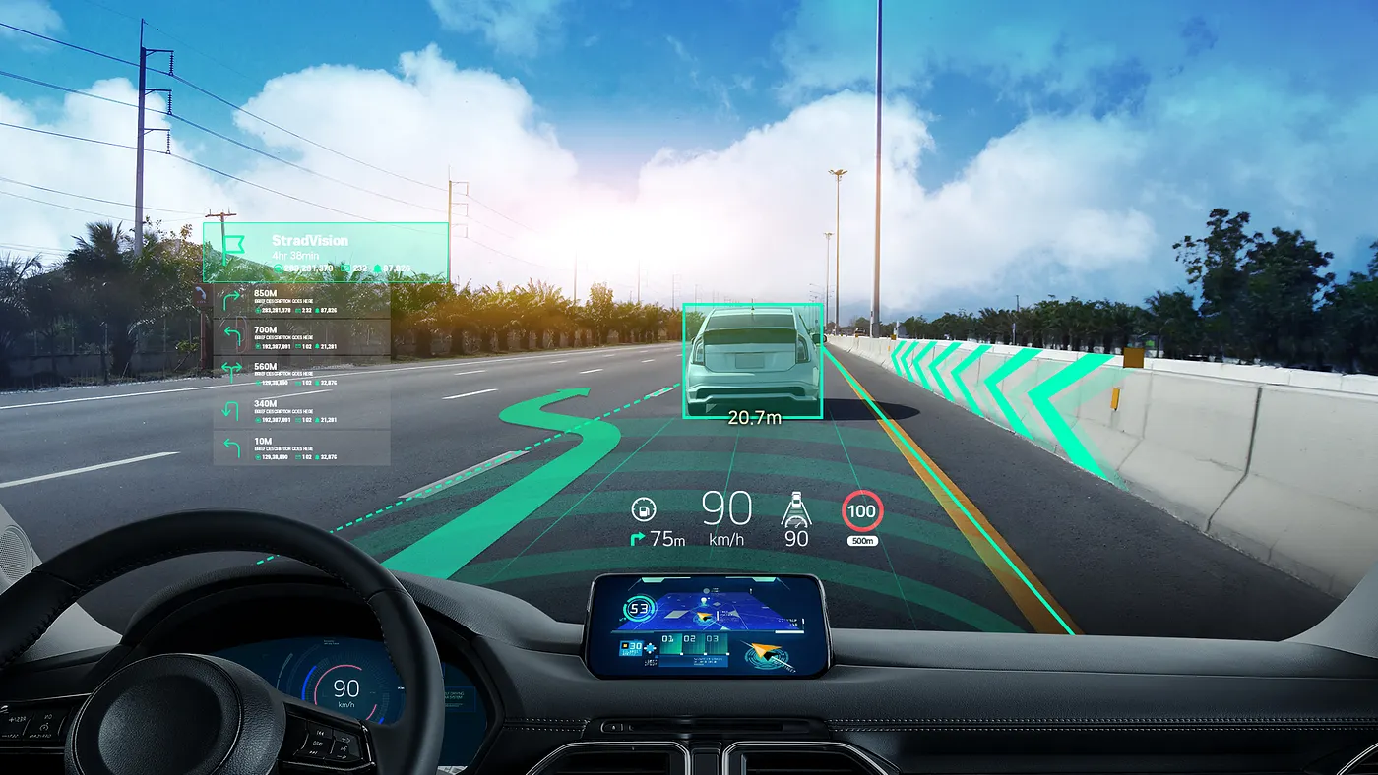
Overview
Problem
Current
Data
Opportunity
Current AV adoption is limited not by capability, but by trust.
Despite rapid advances in autonomous driving, consumers remain uneasy about riding in self-driving vehicles.
Existing in-vehicle displays focus on navigation, not the vehicle’s perception or decision-making process.
Without transparent interfaces, riders feel disconnected from safety logic
= slowing mainstream adoption of autonomous mobility.
According to McKinsey (2024), 67% of consumers cite “lack of trust and transparency” as the primary reason for avoiding AVs.
Passengers cannot see or understand what the AV perceives, leading to anxiety, disengagement, and over-reliance on emergency overrides.
Build transparency and trust through real-time, visual communication between human and vehicle.
Notes:
https://medium.com/stradvision/augmented-reality-head-up-display-ar-hud-provides-drivers-with-a-safer-and-more-convenient-25db611fd406

Slide 18
Stakeholders + Monetization
04
Stakeholder Analysis:
Primary Customer (B2B): Automotive OEMs & Tier-1 Suppliers
Why: Traditional AR HUDs only display limited driving data (speed, navigation, warnings).
→ VISTA introduces a full-windshield, spatially aware interface that visualizes how the AV perceives and reacts to its environment.
Value: A complete visual awareness layer that bridges the trust-gap between human passengers and autonomous systems.
OEMs can integrate VISTA into next-generation EVs and AVs as a signature safety and transparency feature.
End-User (B2C / Fleet Experience): AV Fleet Operators, Ride-Hailing Platforms, and Robotaxi Networks
Why: Fleet adoption relies heavily on rider comfort and confidence.
Value: VISTA enhances passenger experience by allowing riders to “see what the vehicle sees,” reducing anxiety and improving perceived safety.
Operators gain a measurable trust metric through engagement and reduced ride cancellations.
Hardware Integration Revenue
AND
SaaS Subscription (Recurring Software Revenue)

Slide 19
Market Analysis
1. AR Automotive Display Market
Valued at USD 1.5B in 2023
Expected to exceed USD 15B by 2032 (CAGR ~28%)
Growth driven by premium OEM adoption of AR HUDs and in-vehicle transparency features
2. Global Autonomous Vehicle Market
Valued at USD 54B in 2024, projected to reach USD 620B by 2032 (CAGR ~35%)
OEMs and AV developers are investing in UX systems that improve rider comfort and trust
3. Consumer Trust Gap
67% of consumers cite “lack of trust and transparency” as their main hesitation toward AVs
40% increase in adoption likelihood when riders can visualize AV intent and perception
Tier | Definition | Market Size (USD) | Key Assumptions
TAM | Portion of global AV market constrained by trust gap and solvable via transparency UI | $7.8B | $620B × 25% (trust-limited) × 5% (UI layer value)
SAM | AVs in AR-HUD-ready regions (NA, EU, East Asia) | $2.3B | 60% region coverage × 50% HUD readiness
SOM | 5-year attainable share via OEM & fleet integrations | $160M | 7% SAM penetration × $150 SaaS × 5-year cycle
Notes:
Precedence Research (2024) – “Augmented Reality Head-Up Display Market Size, Share, Growth 2024–2032” → Global AR HUD market size was USD 1.5 billion in 2023 and projected to reach USD 15.3 billion by 2032 (CAGR 28 %). 🔗 https://www.precedenceresearch.com/augmented-reality-head-up-display-market
Market Research Future (2024) – “Automotive AR HUD Market Report 2024–2035” → Market estimated USD 0.97 billion (2024) → USD 14.77 billion by 2035 (CAGR 29.3 %). 🔗 https://www.marketresearchfuture.com/reports/automotive-augmented-reality-hud-market-27509
TAM — Total Addressable Market
Definition: The share of the global AV ecosystem constrained by lack of consumer trust — the part VISTA directly solves.
Inputs & Assumptions:
Global Autonomous Vehicle Market (2032) = $620B (Fortune Business Insights, 2024).
McKinsey (2024): 67% of consumers cite lack of trust as main hesitation.
Not all of that 67% translates into immediate addressable revenue; assume only 25% of the global AV value is realistically “trust-limited” and could be influenced by UX transparency layers like VISTA.
Within that segment, VISTA’s AR interface addresses roughly 5% of total vehicle value (software/UI contribution).
SAM — Serviceable Addressable Market
Definition: AVs in regions where consumer trust, regulatory acceptance, and AR hardware integration overlap.
Inputs & Assumptions:
60% of the global AV market concentrated in North America, Europe, and East Asia (OECD, 2024).
Only 50% of those regions will have AR HUD or compatible display hardware by 2032.
Regional cultural and safety regulations make transparency features a near-term priority.
SOM — Serviceable Obtainable Market
Definition: Realistic 5-year market capture through early OEM and fleet partnerships.
Inputs & Assumptions:
OEM penetration (2026–2031): 7% of SAM (gradual, conservative adoption).
Average annual SaaS license: $150 per vehicle/year.
Average deployment lifecycle: 5 years.

Slide 21
Thank you
Please keep this slide for attribution

